Slide 1
JOptionPane Dialogs

Slide 2
Message Dialogs
Swing provides a bare JDialog class that can be used to create custom dialog windows, but for typical dialog interactions with your users, the JOptionPane class has some really handy shortcuts.
Perhaps the single most annoying pop up is the “something broke” dialog letting you know that the application is not working as expected.
This pop up shows the user a brief message and an OK button that can be clicked to get rid of the dialog.
The purpose of this dialog is to hold up operation of the program until the user acknowledges that they have seen the message.

Slide 3
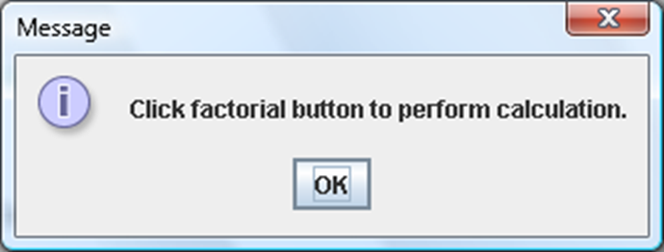
JOptionPane
A dialog box is a simple window with a message:
To generate a simple output dialog box, call JOptionPane's showMessageDialog method:
JOptionPane.showMessageDialog(null, <String message>);
JOptionPane.showMessageDialog(null, "Click factorial button to perform calculation.");

Slide 4
JOptionPane Presents 3 Dialog Types
Message Dialogs – Display messages to the user only.
Confirmation Dialogs - asks a question and requires the user to respond with an appropriate button.
Input Dialogs - used to receive input from the user. The input will be in a String.
The JOptionPane class is in the javax.swing package so import that package: import java.swing.*; or import java.swing.JOptionPane;

Slide 5
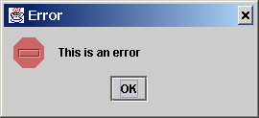
A message dialog box simply displays a message to alert the user and waits for the user to click the OK button to close the dialog.
null means the dialog will be
centered on the screen
JOptionPane.showMessageDialog(null, “This is an error",
“Error", JOptionPane.INFORMATION_MESSAGE);

Slide 6
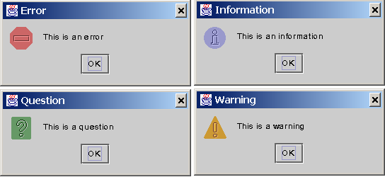
Message Types
The messageType is one of the following constants:
JOptionPane.ERROR_MESSAGE JOptionPane.INFORMATION_MESSAGE
JOptionPane.QUESTION_MESSAGE JOptionPane.WARNING_MESSAGE
There is also a PLAIN_MESSAGE

Slide 7
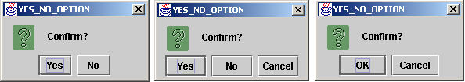
Confirmation Dialogs
A confirmation dialog asks a question and requires the user to respond with an appropriate button.
The confirmation dialog returns a value that corresponds to a selected button.
Return types for Confirmation Dialog ➔
JOptionPane.YES_OPTION
JOptionPane.NO_OPTION
JOptionPane.CANCEL_OPTION
JOptionPane.OK_OPTION

Slide 8
Option Types
The Option Types are:
DEFAULT_OPTION
YES_NO_OPTION
YES_NO_CANCEL_OPTION
OK_CANCEL_OPTION

Slide 9
Example of a Confirmation Dialog
int response = JOptionPane.showConfirmDialog(null, "Do you want to continue?", "Confirm", JOptionPane.YES_NO_OPTION, JOptionPane.QUESTION_MESSAGE);
if (response == JOptionPane.NO_OPTION) {
System.out.println("No button clicked");
} else if (response == JOptionPane.YES_OPTION) {
System.out.println("Yes button clicked");

Slide 10
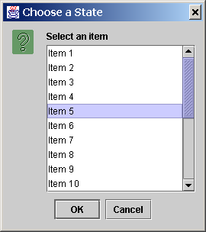
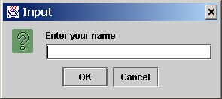
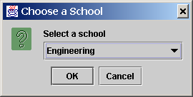
Input Dialogs
An input dialog box is used to receive input from the user.
The input can be entered from a text field or selected from a combo box or a list.
Selectable values can be specified in an array, and a particular value can be designated as the initial selected value.

Slide 11
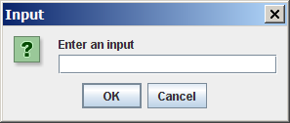
Getting Input from a simple Input Dialog
String input = JOptionPane.showInputDialog(
"Enter an input");

Slide 12
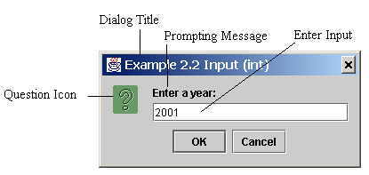
Not So Simple Input Dialog
String string = JOptionPane.showInputDialog(
null, “Prompting Message”, “Dialog Title”,
JOptionPane.QUESTION_MESSAGE);

